Slide 1
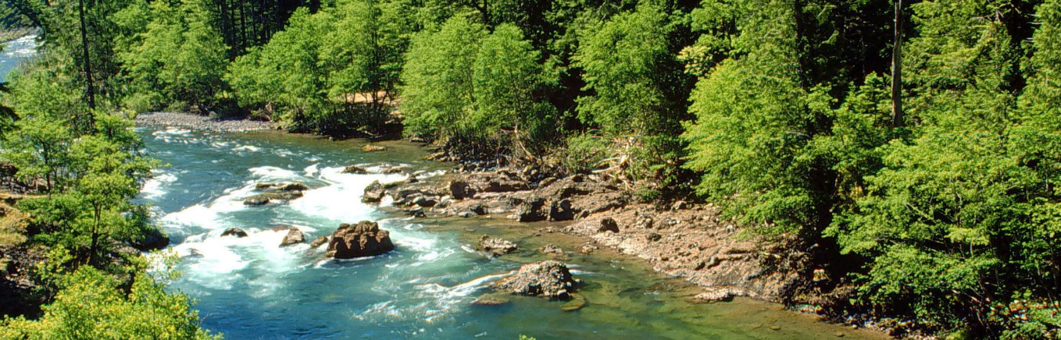



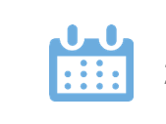
Groundwater Baseflow Study for Water Supply Resiliency in the Clackamas River Watershed
Presenter: Jamie Feldman
Co-authors:
Kim Swan, CRWP
Rob Annear and Lucas Nguyen, Geosyntec Consultants
5-12-2022

Slide 2
Overview
Project Background
Project Goal
Data Analysis
Conclusions

Slide 3
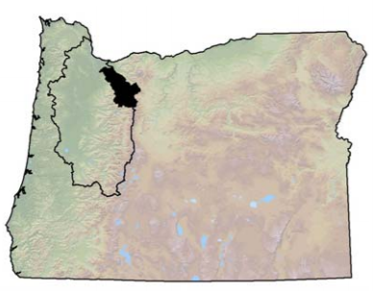
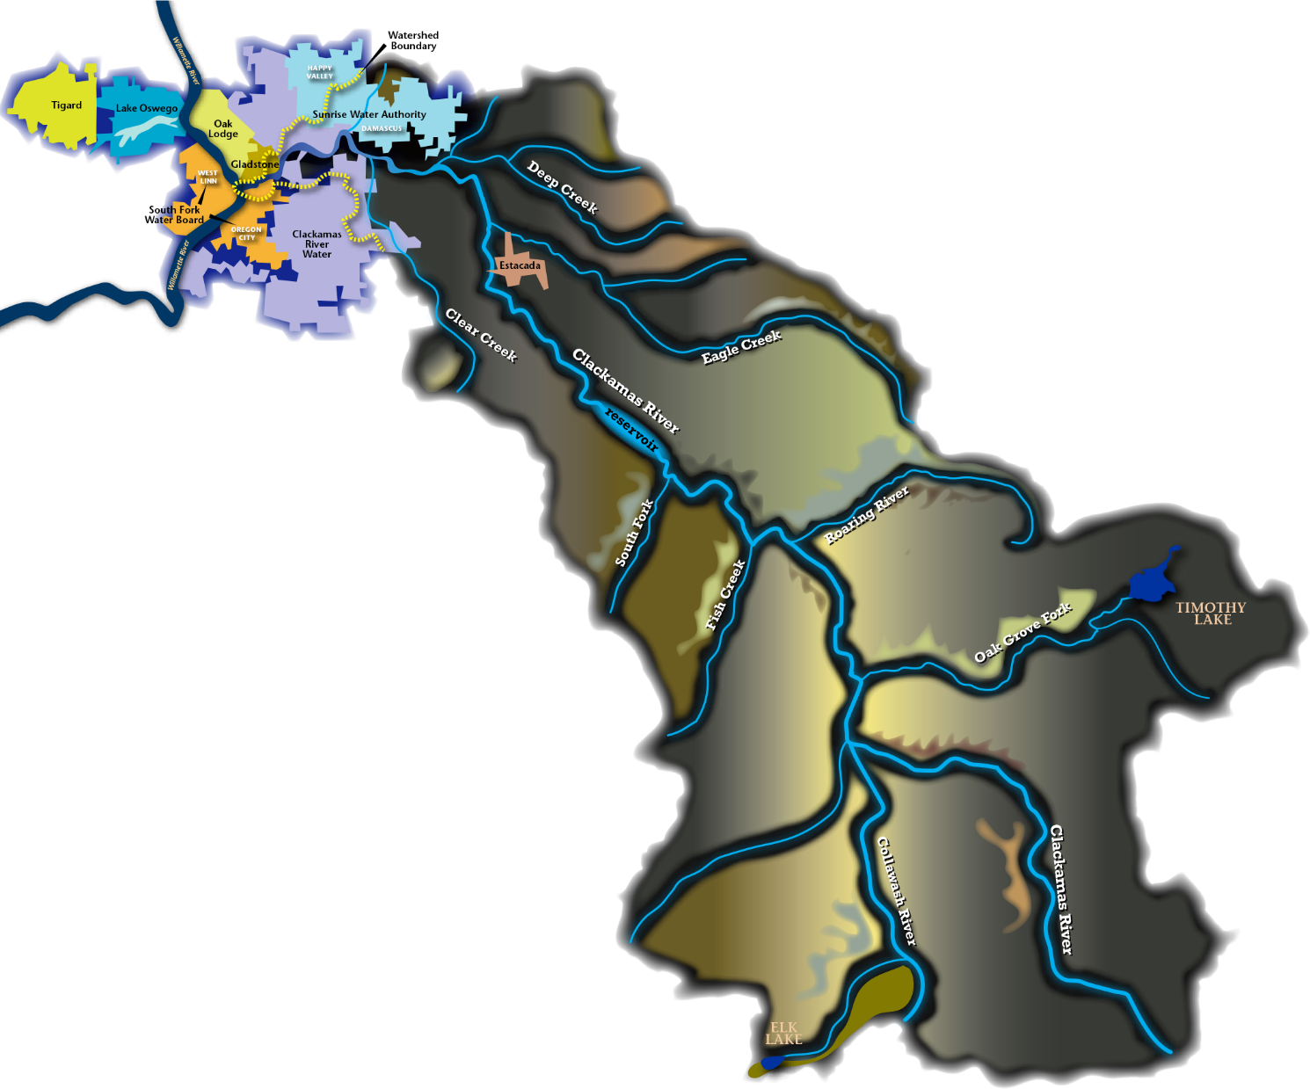

Project Background
Clackamas River Water Providers:
  Drinking water to over 300,000 people
  Meet fish flow requirements
Hydrology:
  Late summer baseflow fed by groundwater
  Climate change expected to reduce snowpack

Slide 4

Project Goal
Identify statistical relationships between snowpack, groundwater, and streamflow to inform drinking water management and fish flow compliance in the face of climate change.
The 71 Percent

Slide 5
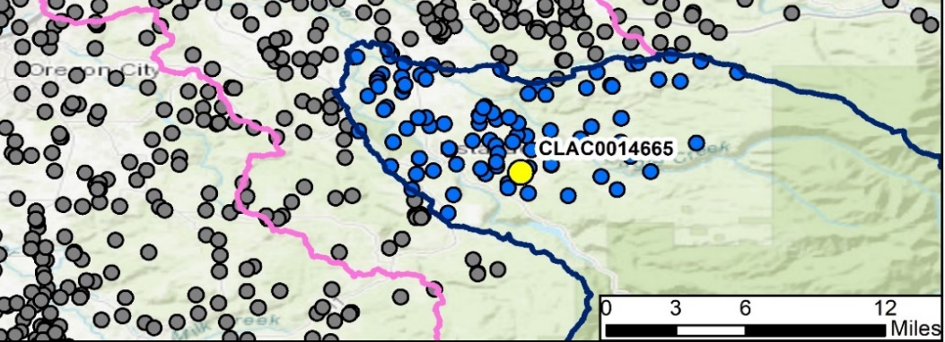

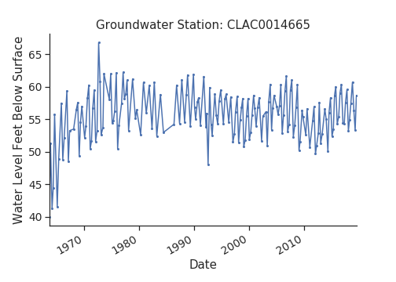
Data Analysis: Data Availability
Sufficient streamflow data from USGS
Sufficient snow water equivalent (SWE) data from SNOTEL
Major gaps in groundwater level data
Single groundwater gauge

Slide 6
Data Analysis: Trends and Statistics
Visual and statistical analysis:
  Timeseries analysis
  Linear regressions
  Seasonal decomposition
Criteria for statistical significance:
  Correlation coefficient (Pearson R) value between 0.5 and 1
  P-value between 0 and 0.1

Slide 7
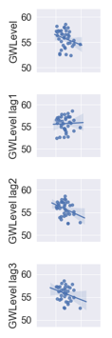
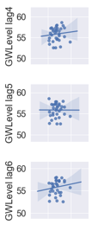
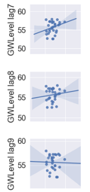
Data Analysis: Snowpack & Groundwater
Goal: find out if groundwater level is directly related to snow water equivalent
Correlations between water-year average snowpack and groundwater level lagged by several years
No statistically significant correlations found

Slide 8
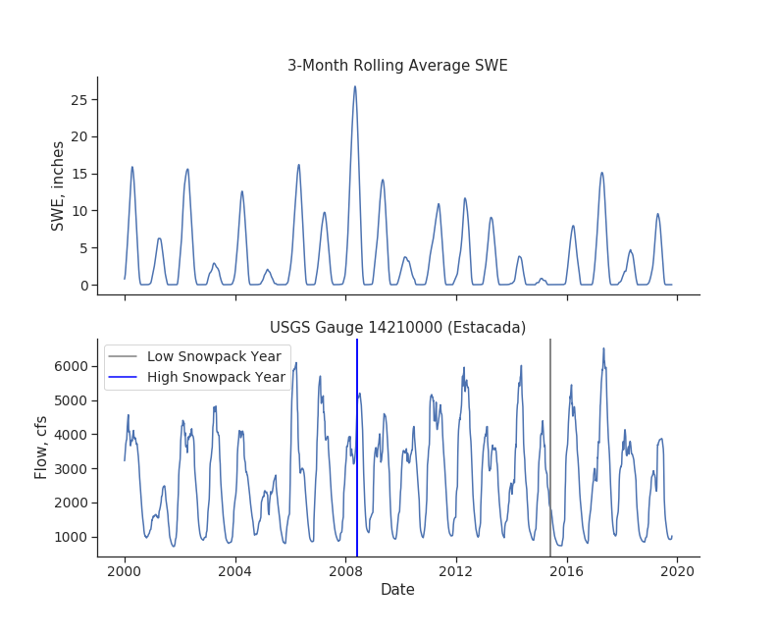
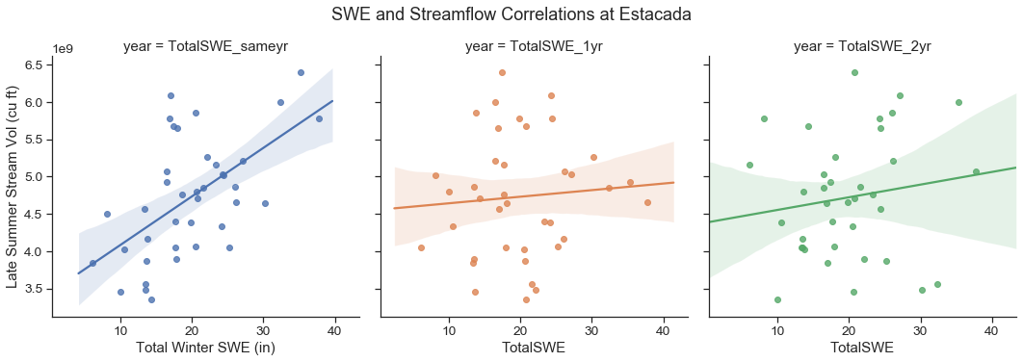
Data Analysis: Snowpack & Streamflow
Potential visual relationship between seasonal maximum snowpack and the following summer’s baseflow.
Almost 60% of the variability in late summer stream flow can be accounted for by that year’s total winter snowpack (but not winters prior to that).
Same water year
1 water year offset
2 water years offset
Notes:
This visual analysis of seasonally averaged snowpack and streamflow suggests a potential relationship between the height of the SWE peak and the height of the baseflow valley. For example, the blue line shows a wet year in 2008. Lots of snowpack precedes a dip in streamflow that does not fall quite as low as the surrounding years. Conversely, in 2015 we see a dry year with relatively little snowpack which is followed by a dip in streamflow that is lower and longer than its neighboring years.

Slide 9
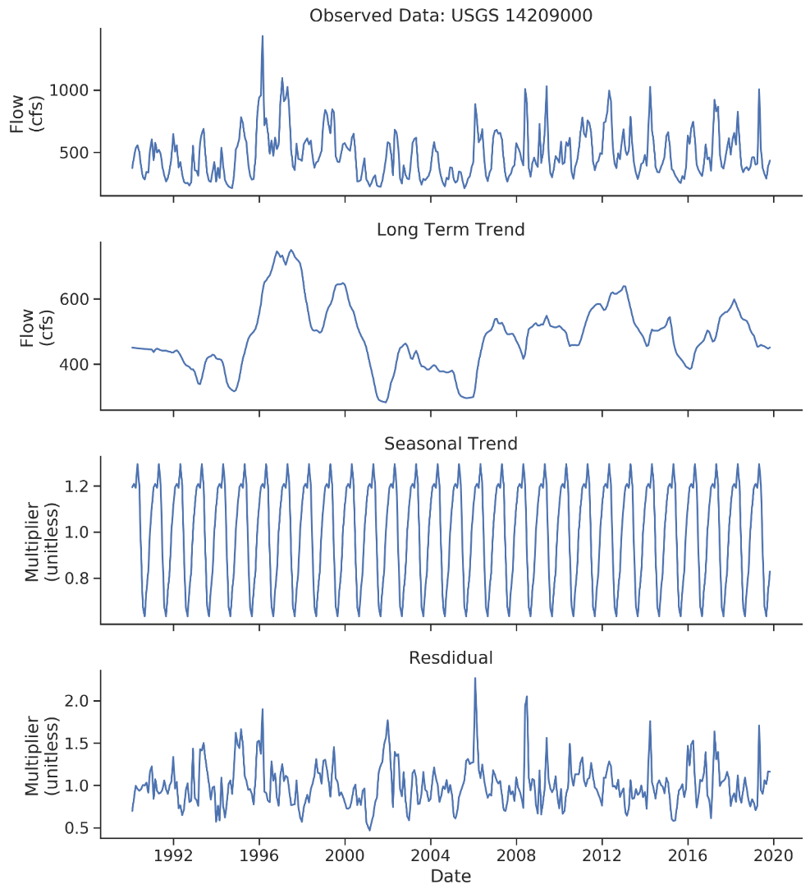
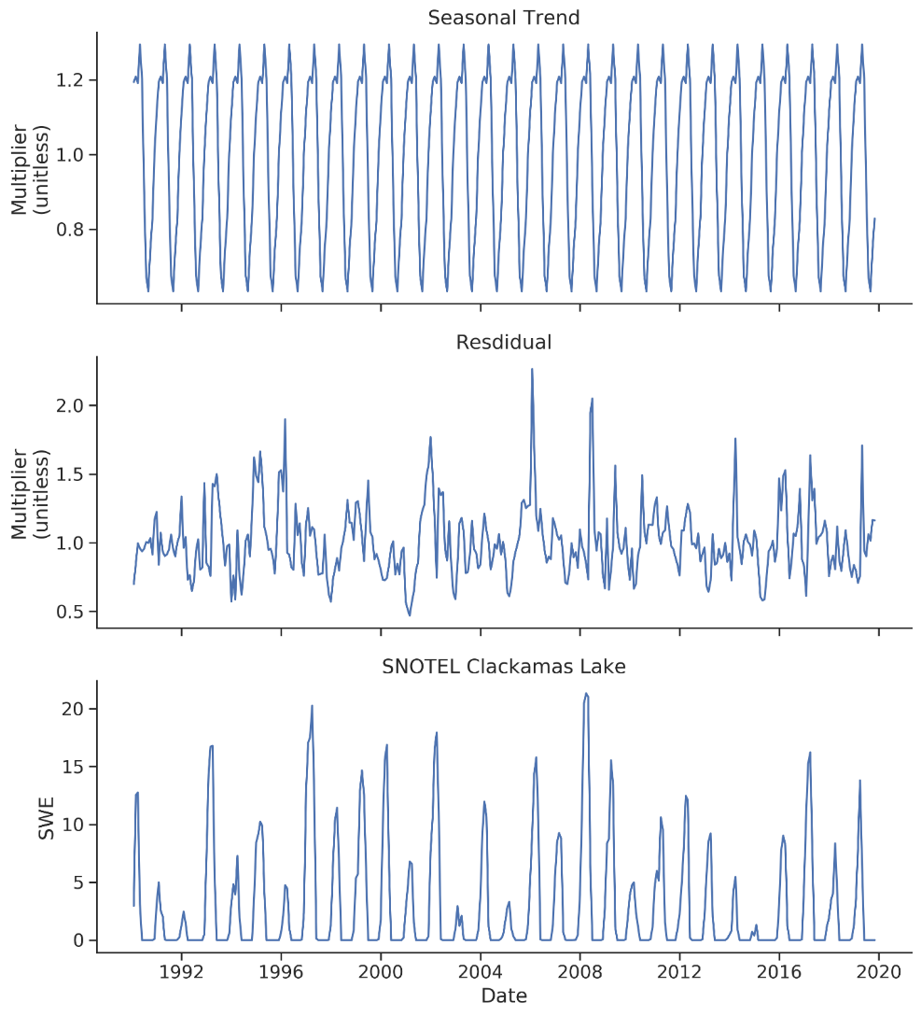
Data Analysis: Streamflow Decomposition
The monthly mean timeseries seasonal decomposition reveals:
  Long-term trend (baseflow)
  Seasonal component (seasonal runoff)
  Residuals (single occurrence flow events)
  Coincidence with snowpack

Slide 10
Conclusions
Some predictive power over late summer stream flow
  ~60% of the variability accounted for by snowpack of the prior winter
  Confounded by complex hydrology and hydrogeology of watershed
Recommendations:
  Expand groundwater monitoring programs
  Keep an eye on annual snowpack trends
  For greater predictive power, model Upper Basin with linked surface water-groundwater model like PRMS+MODFLOW or even HSPF.

Slide 11
Contact Info
Jamie Feldman
Water Resources Professional, Geosyntec Consultants
Email: jfeldman@geosyntec.com
Phone: 971-271-5892
Kim Swan
Clackamas River Water Providers
Email: kims@clackamasproviders.org
Phone: 503-723-3510

